Slide 1
Czech Real Estate Analysis
Author: Matěj Foukal
Course: Seminar on Data Mining (NAIL121)

Slide 2
Objectives
Analize regional real estate trends across the Czech Republic
Understand post COVID market shifts
Compare flat vs house prices across city sizes and regions

Slide 3
Data Sources
Czech Statistical Office - Czech Statistical Office
Datasets:
Průměrné kupní ceny nemovitostí - územní srovnání
Průměrné ceny nemovitostí - časové řady

Slide 4
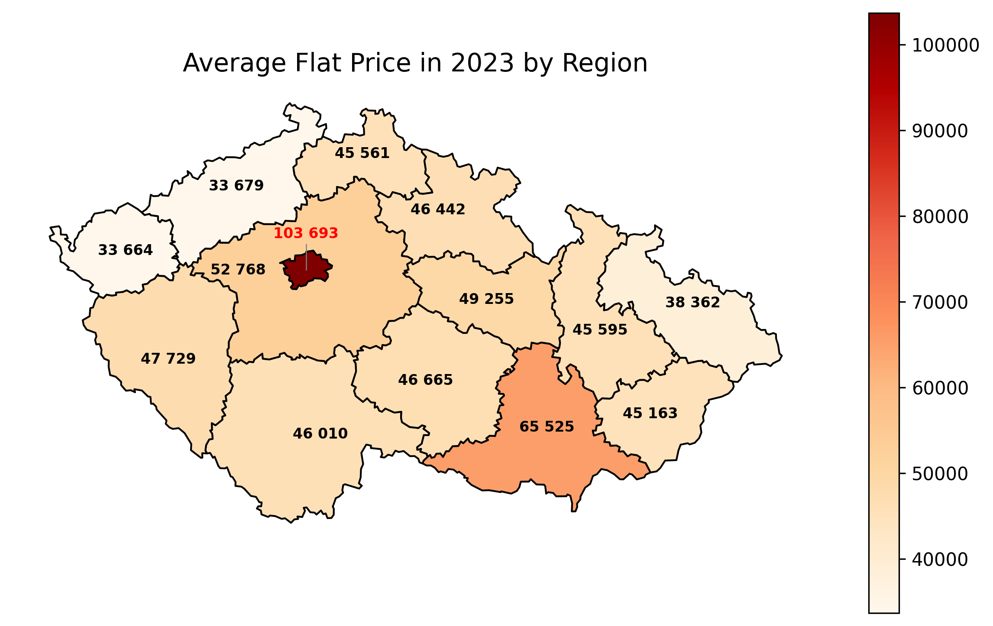
Q1: Where was it most expensive to buy a flat in 2023?

Slide 5
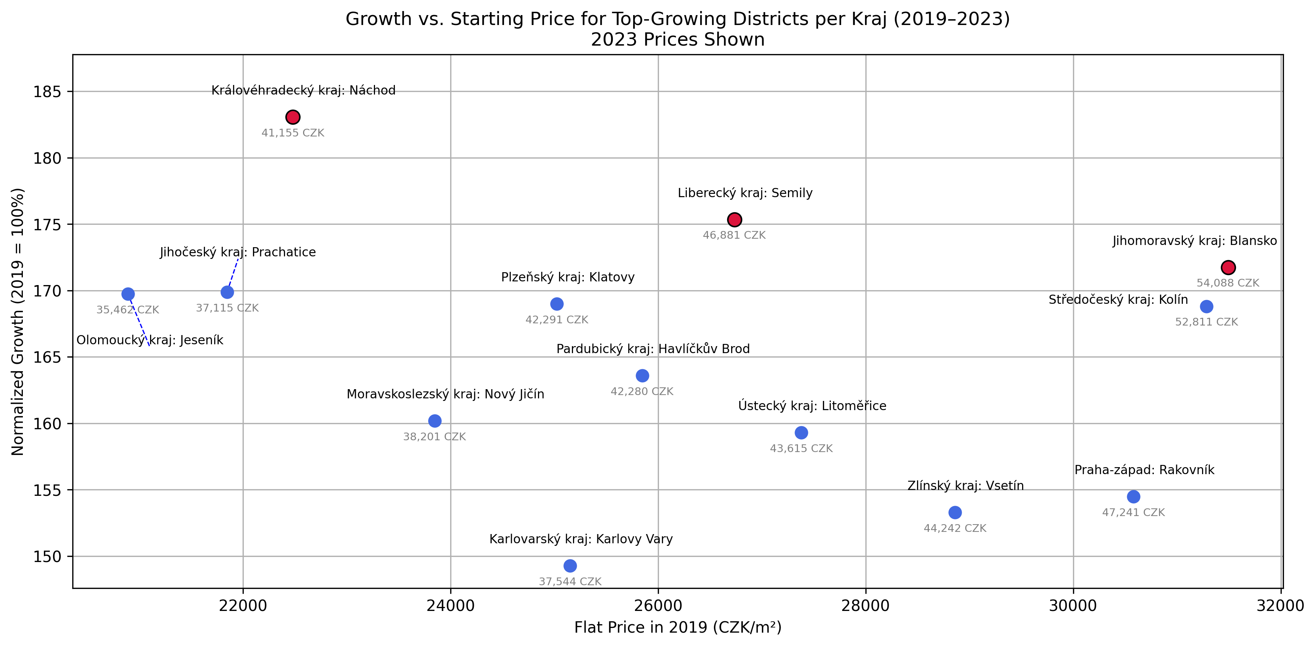
Q2: Which district grew the fastest in each region from 2019 to 2023?

Slide 6
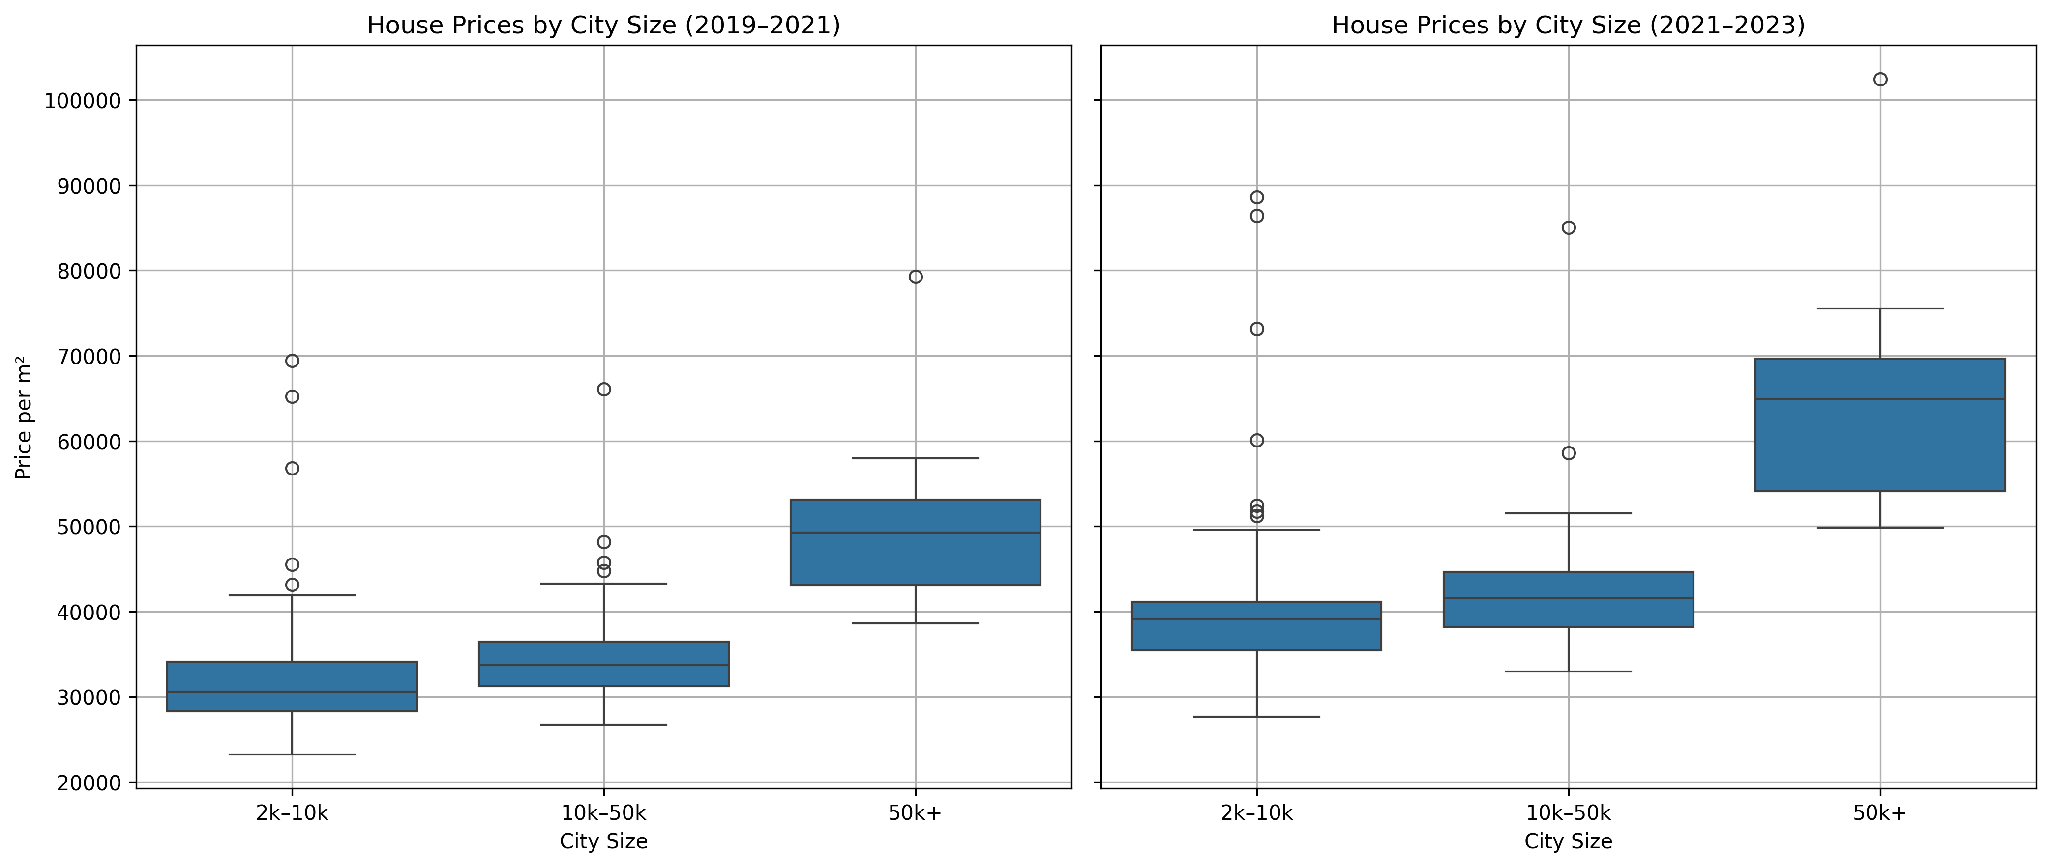
Q3: Is post-COVID demand favouring smaller cities for houses?

Slide 7
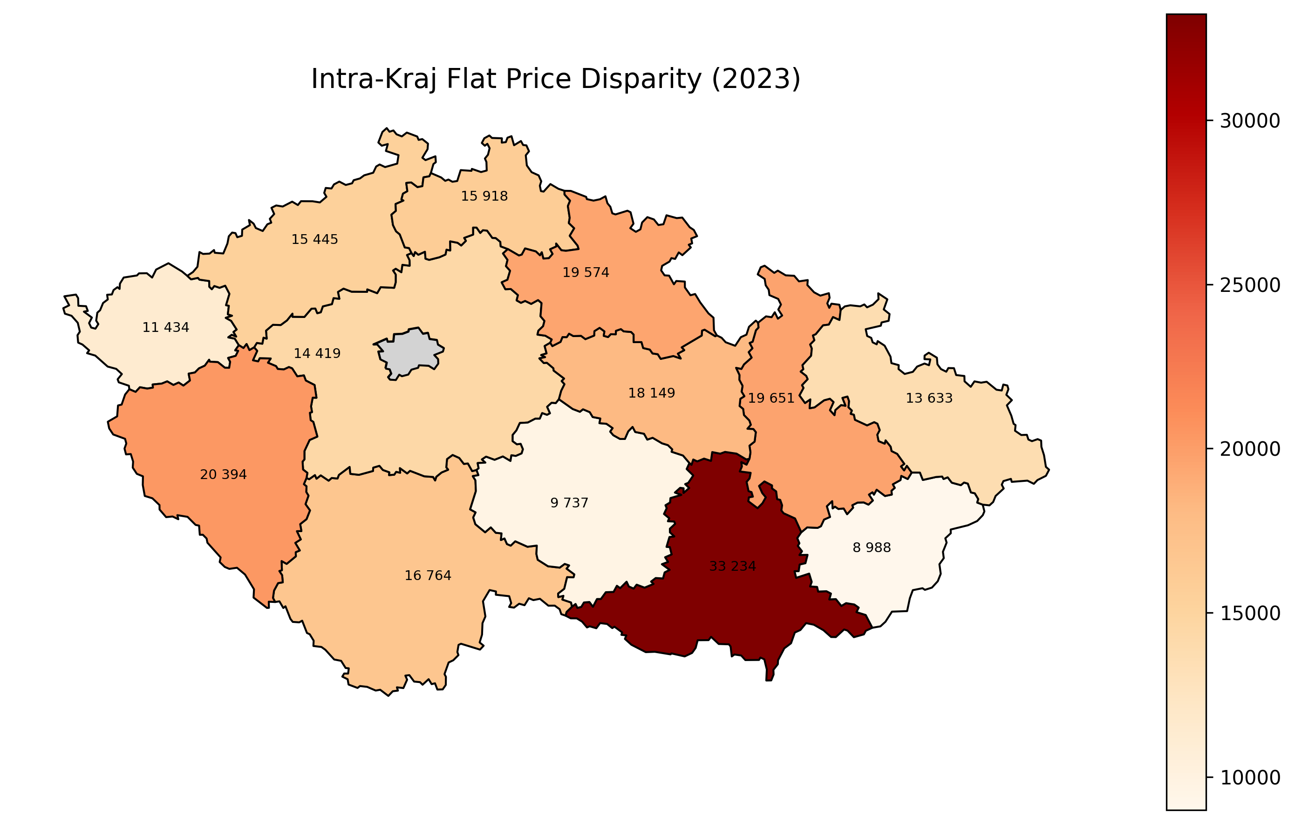
Q4: In which regions is the flat market the most uneven?

Slide 8
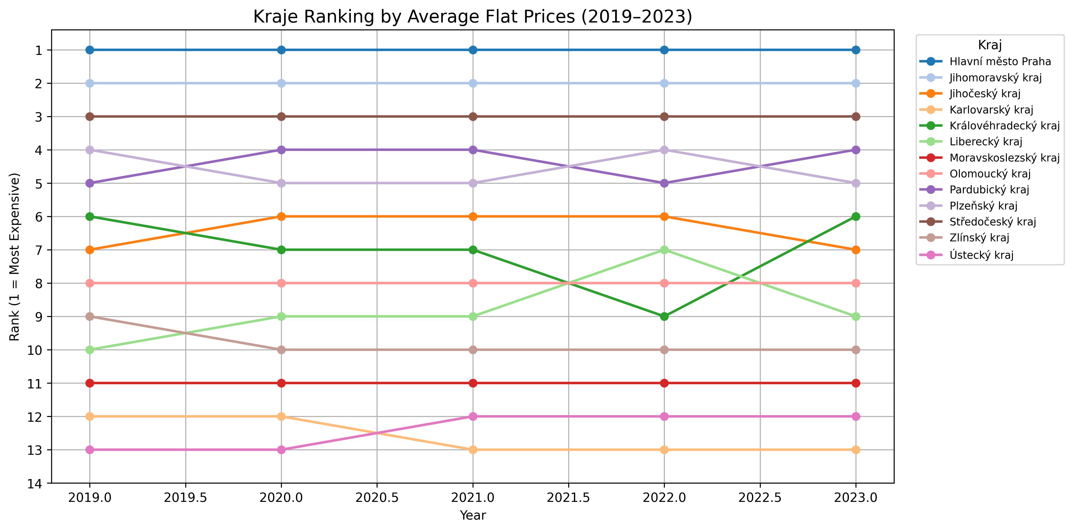
Q5: Which regions became more or less expensive since 2019?

Slide 9
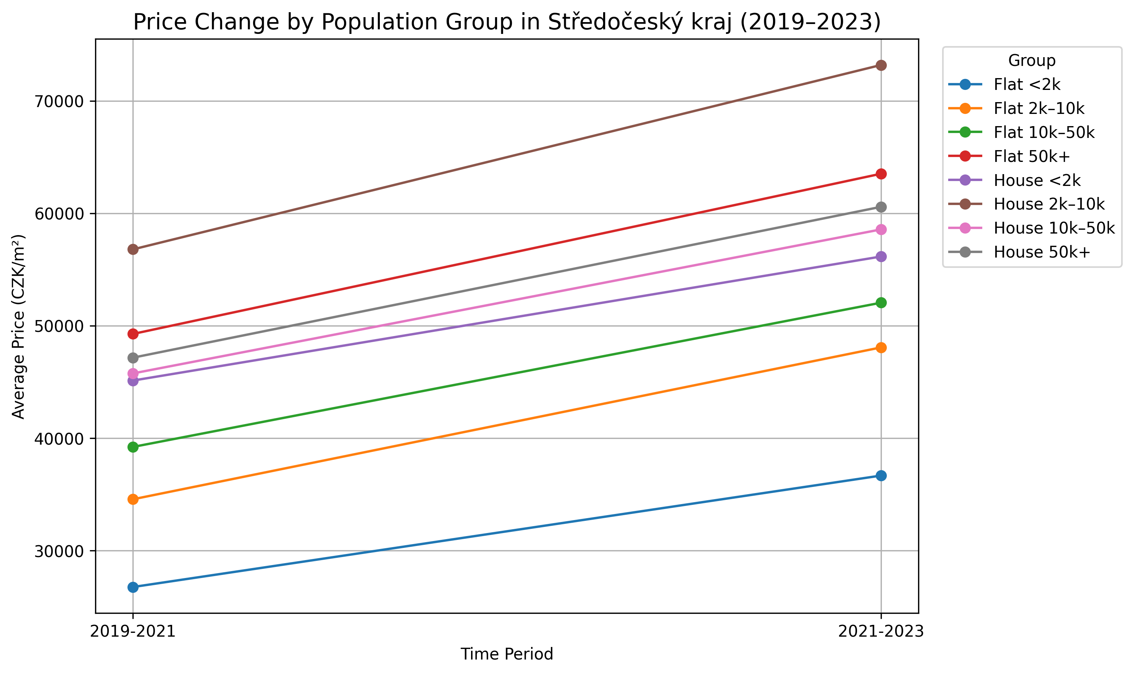
Q6: How have prices changed across city sizes in Středočeský kraj?

Slide 10
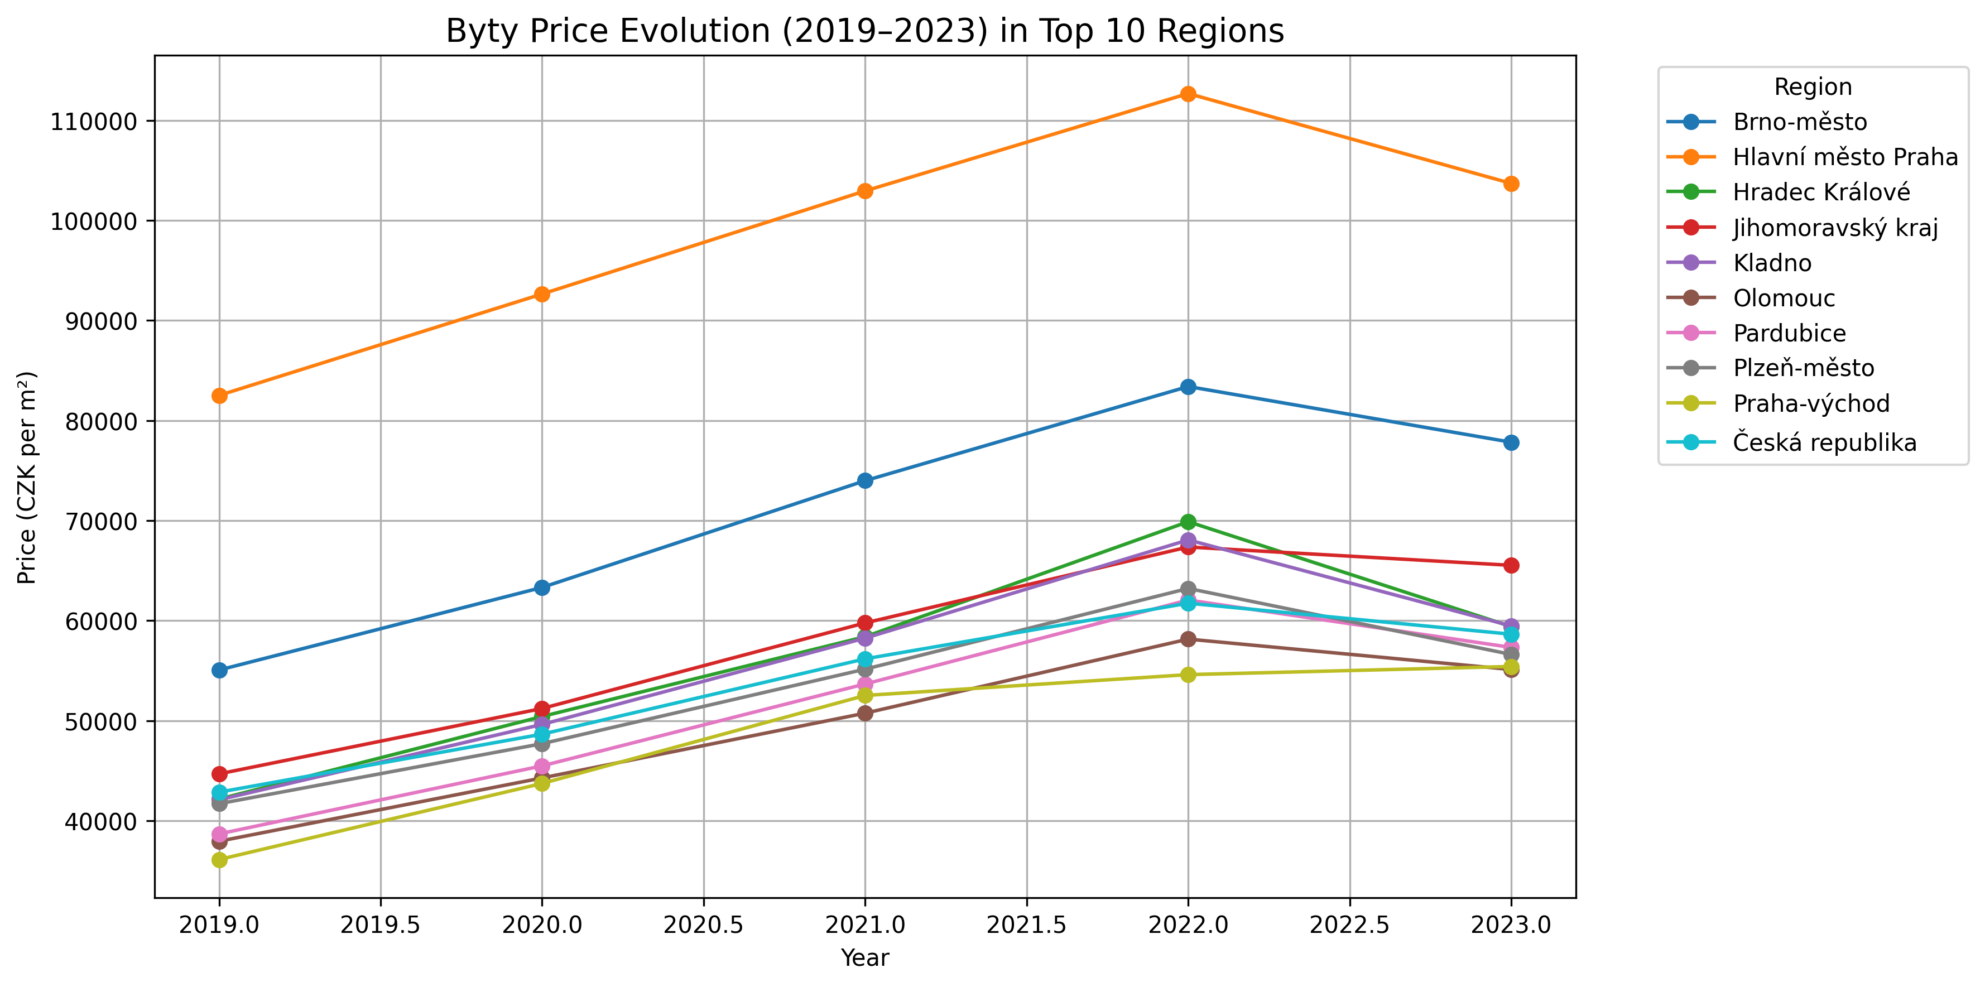
Q7: Was there a peak in flat prices and if so when?

Slide 11
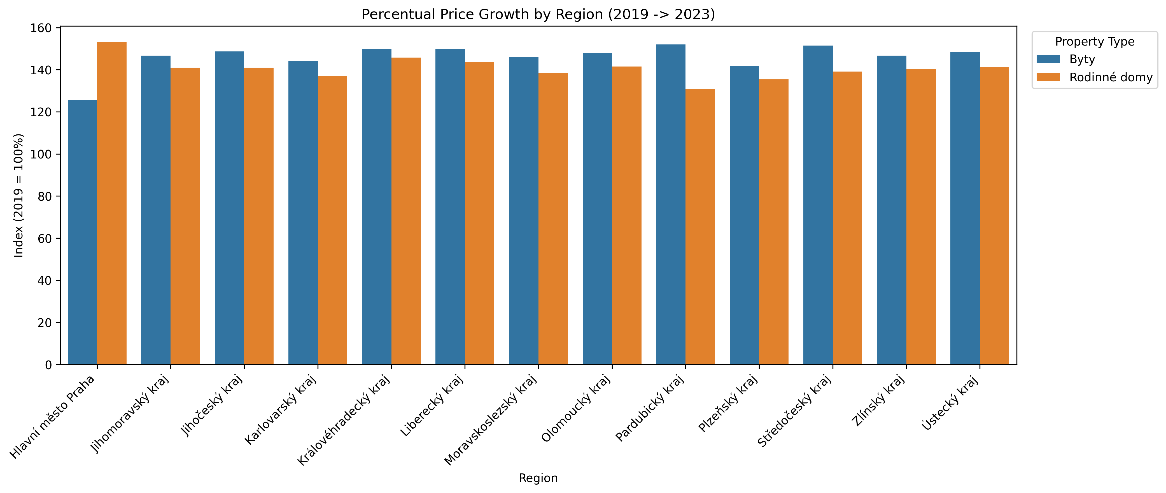
Q8: Are houses or flats gaining more value since 2019?

Slide 12

GitHub Repository Link

